Slide 1
AirWatch The Air Quality Tracker

Slide 2



OUR TEAM
RAJA SAHA
12209471
MINAKSHI SAHU 12213937
ANURAG VERMA 1220995

Slide 3

ACKNOWLEDGMENT
We express our sincere gratitude to Dr. Akhil Gupta for his invaluable insights and unwavering guidance throughout the development of our project. His expertise and support have been instrumental in shaping the success of our endeavor.
DR. AKHIL GUPTA Assistant Professor
LPU

Slide 4
TABLE OF CONTENTS
01 Introduction
02 Problem Statement
03 Solution Overview
04 System Architecture
05 Examples
06 Use Cases

Slide 5
INTRODUCTION
In an era where air pollution has emerged as a major concern, affecting the lives and well-being of individuals and communities, our innovative solution, "AirWatch," steps in as a beacon of hope. It not only acknowledges the gravity of the air quality issues we face but actively addresses them. With AirWatch, we offer a powerful and user-friendly means to monitor air quality, empowering users to take proactive steps to safeguard their health and the environment.

Slide 6
IMPACT OF AIR POLLUTION
HEALTH
ENVIRONMENT
QUALITY OF LIFE
Air pollution harms health, causing respiratory and cardiovascular problems, especially in children.
Air pollution damages the environment, leading to ecological harm, climate change, and soil/water quality issues.
Poor air quality causes discomfort, stress, and limits outdoor activities, especially for vulnerable groups like children and the elderly.

Slide 7
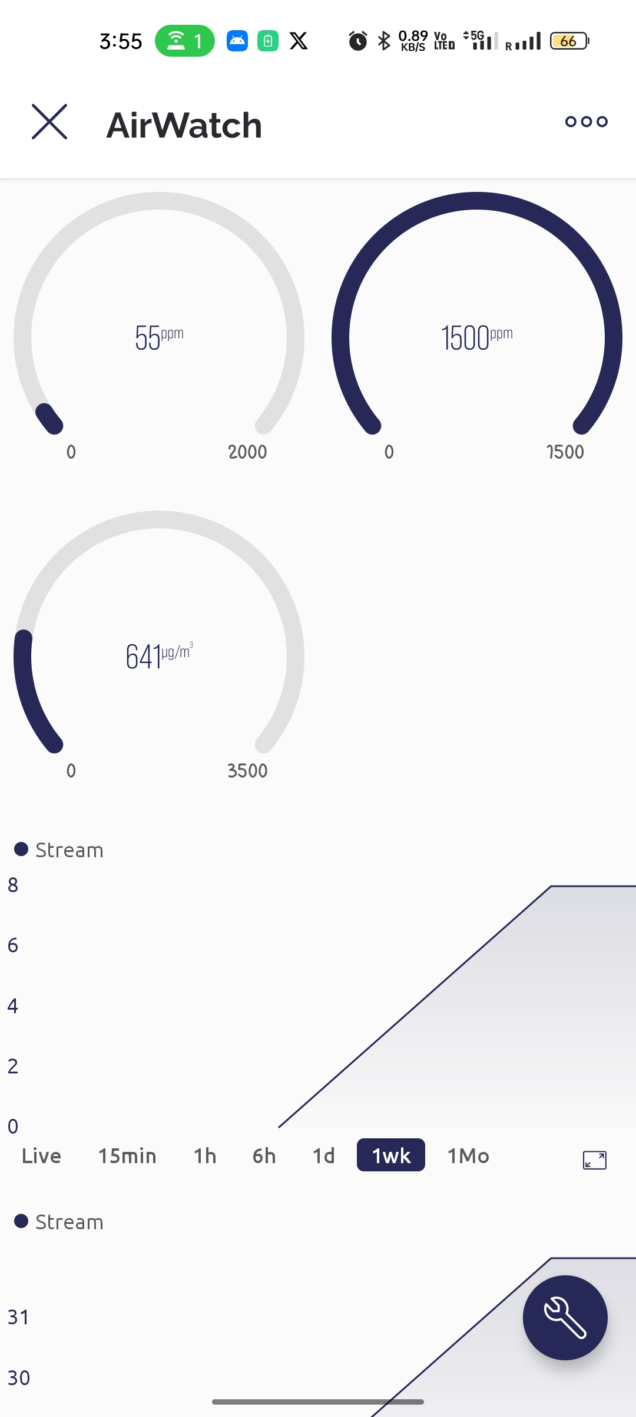
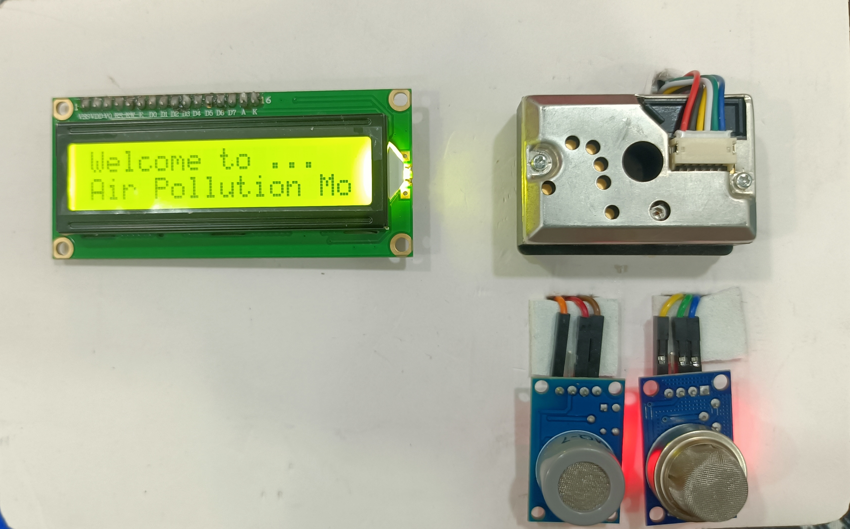
Here comes our concept ‘AirWatch’
a cutting-edge system equipped with advanced hardware for the real-time detection of harmful gases. AirWatch empowers users with immediate alerts, enabling them to take proactive measures in addressing air quality concerns and safeguarding their health.

Slide 8
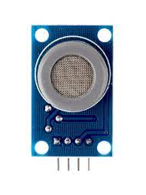
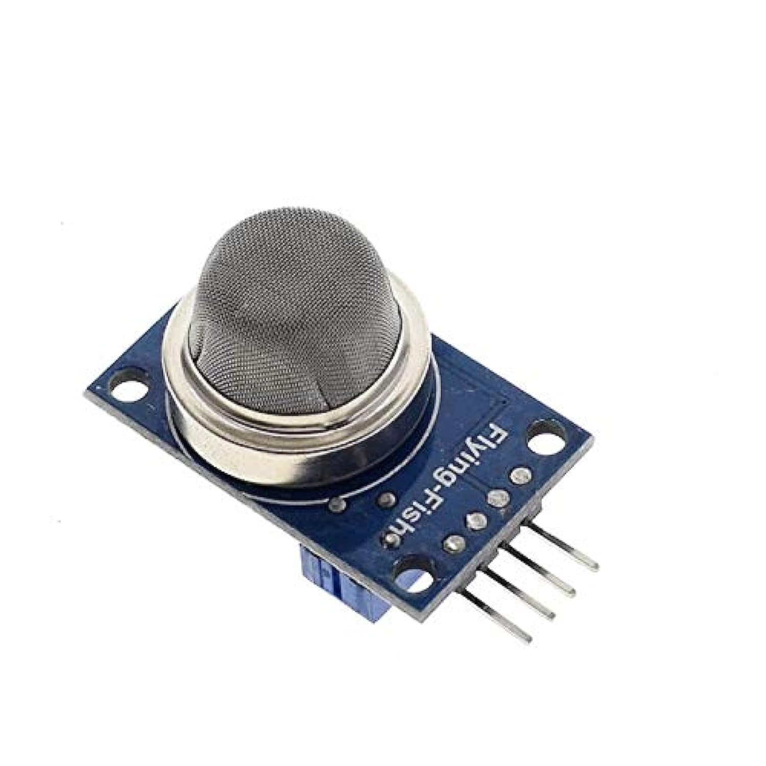
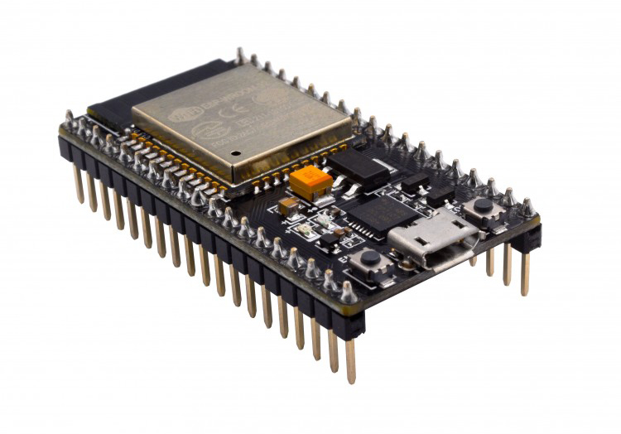
SYSTEM ARCHITECTURE
MQ7
MQ135
ESP32
MQ7 gas sensor detects carbon monoxide (CO) levels with precision.
MQ135 air quality sensor monitors a wide range of gases, ensuring comprehensive data.
ESP32, the central hub, provides robust processing power and connectivity.

Slide 9
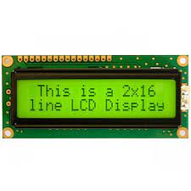
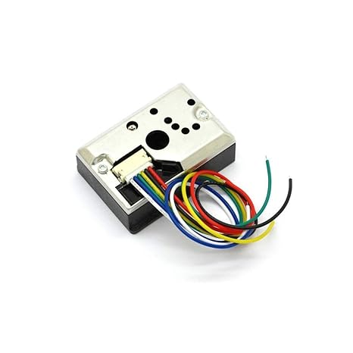
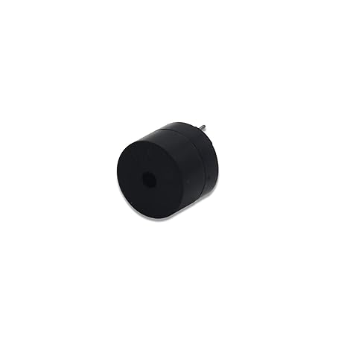
SYSTEM ARCHITECTURE
LCD
PM 2.5
BUZZER
The 16x2 LCD display real-time data in a clear and concise format.
The PM2.5 dust sensor provides accurate readings of fine particulate matter for air quality assessment.
The piezo buzzer generates audible alerts for immediate user notification.

Slide 10
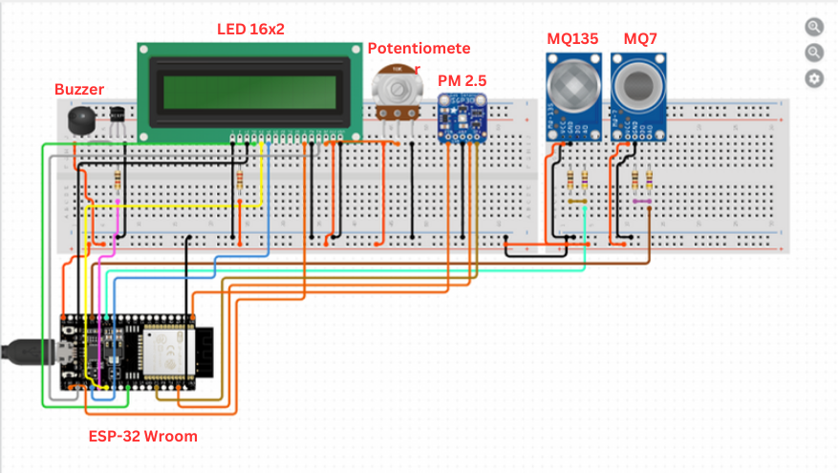
SYSTEM ARCHITECTURE

Slide 11
SYSTEM COST
Items | Quantity | Price
ESP32 | 1 | 425
PM2.5 Sensor | 1 | 350
MQ-7 | 1 | 180
MQ135 | 1 | 195
Buzzer | 1 | 14
Bread Board | 2 | 70
Wires | 30 | 45
Lcd | 1 | 125
Total Cost : 1404

Slide 12
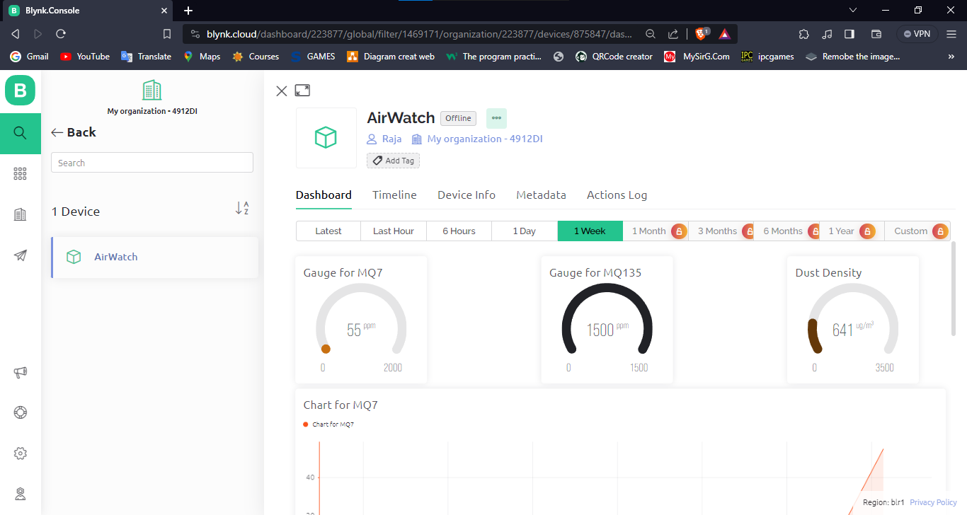
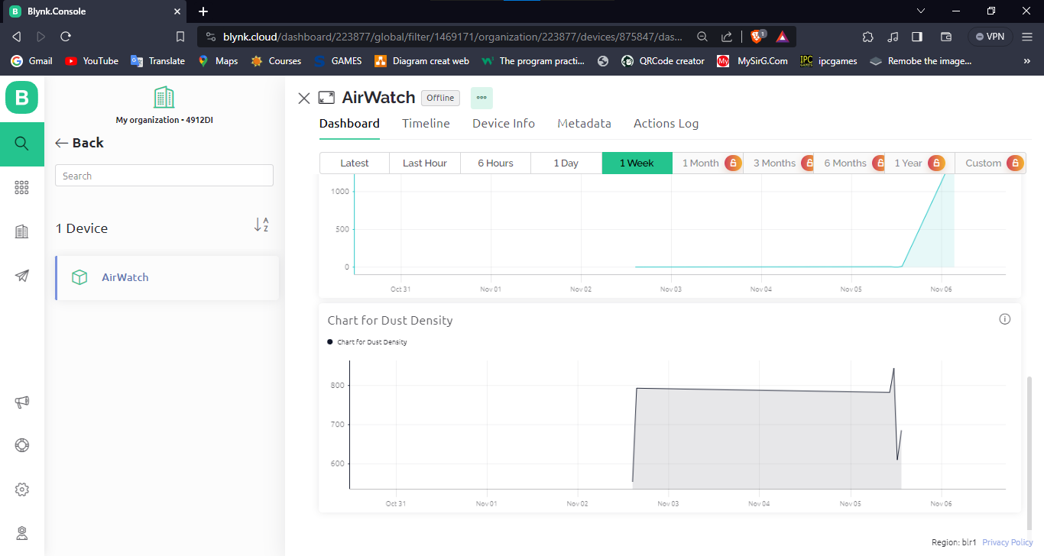
CLOUD INTEGRATION
Our system seamlessly integrates with Blynk's cloud platform, allowing users to access and analyze air quality data remotely in real-time.

Slide 13
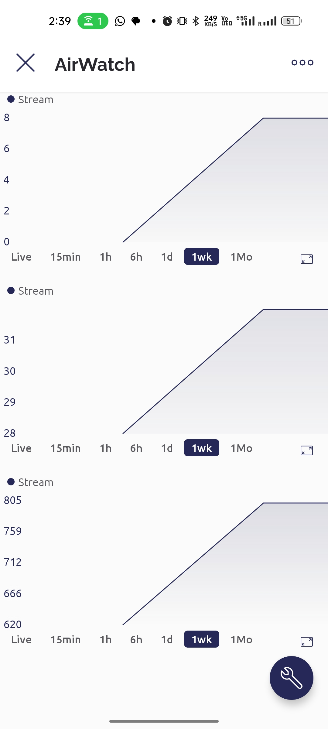
MOBILE APP INTEGRATION
Users can conveniently monitor air quality via the Blynk mobile app, ensuring access to real-time data and alerts on their smartphones.

Slide 14
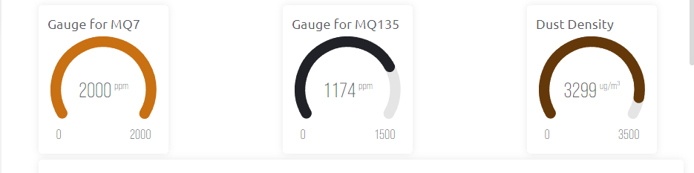
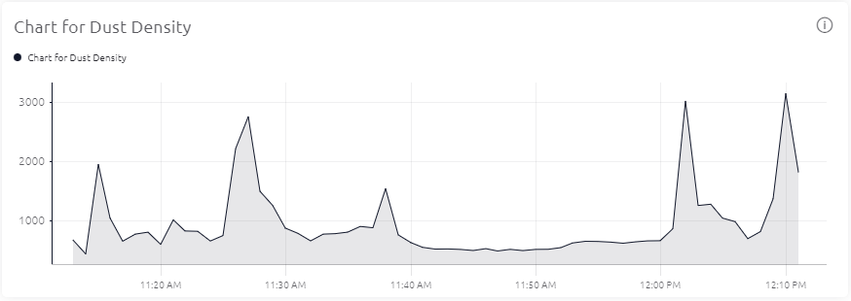
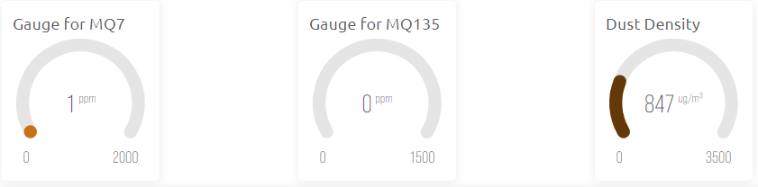
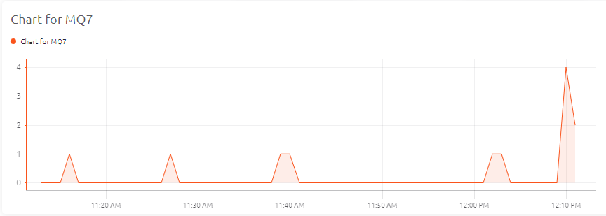
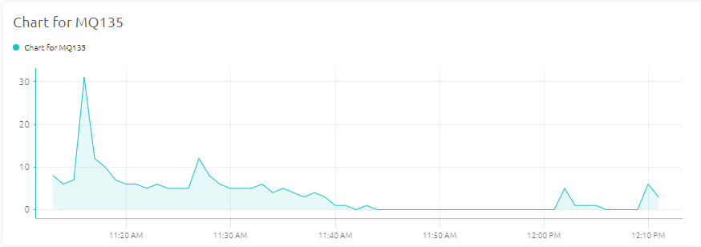
DATA VISUALIZATION

Slide 15
01
DATA OF LPU NEAR UNIMALL

Slide 16
DATA OF JALANDHAR BUS STAND
02

Slide 17
DATA OF LAW GATE NEAR AUTO STAND
03

Slide 18




USE CASE SCENARIOS
HOME
INDUSTRY
URBAN AREAS
HEALTHCARE
Ensure indoor air quality.
Monitor workplace air quality.
Improve city-wide air quality.
Safeguard patients and staff in medical settings

Slide 19




WHY YOU NEED AirWatch
COST EFFECTIVENESS
USER-FRIENDLY GUIDE
CUSTOMIZABLE FEATURES
SCALABILITY
A low-cost device accessible to all.
Empowering non-tech individuals to use it effortlessly.
Tailored to your needs with easy installation.
Easily expandable for growing demands.

Slide 20
Conclusion
Our Air Pollution Monitoring System, with its user-friendly design, real-time alerts, and low cost, is poised to address the pressing issue of air pollution. It has the potential to improve public health and environmental conditions while offering a significant market opportunity.

Slide 21
THANKS!
Feel Free to Ask any Questions

